Slide 1
SOC-Based Storage Participation
From the paper's compact model to a multi-agent complementarity problem
Where we are · September 2026

Slide 2
1 · THE PAPER'S IDEA
Let the operator price the state, not the participant
Storage has no marginal cost — only an opportunity cost, and that cost depends on the whole horizon, on the prices inside it, and on the state-of-charge trajectory. Baldick's proposal is to let the ISO carry the state of charge as a decision variable of its own clearing problem. The participant then submits only physical parameters plus a single scalar value function w(e) for the energy left at the end of the horizon. The intertemporal opportunity cost is therefore computed by the operator, and no participant has to forecast prices in order to bid.
Our question: is the resulting dispatch a competitive equilibrium?

Slide 3
2
The models
Four statements of the same market, each one a step less compressed

Slide 4
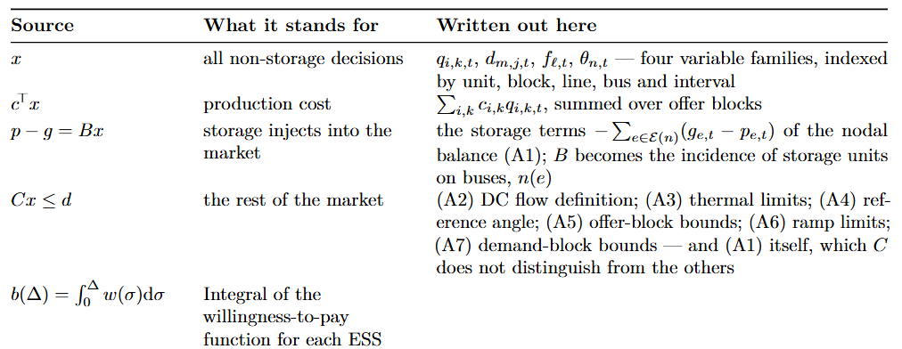
2.1 · THE PAPER'S MODEL
As published: compact form
SOURCE PROBLEM S(9)
So the first thing we had to do was undo the compression — not for presentation, but because the argument does not exist without it.

Slide 5
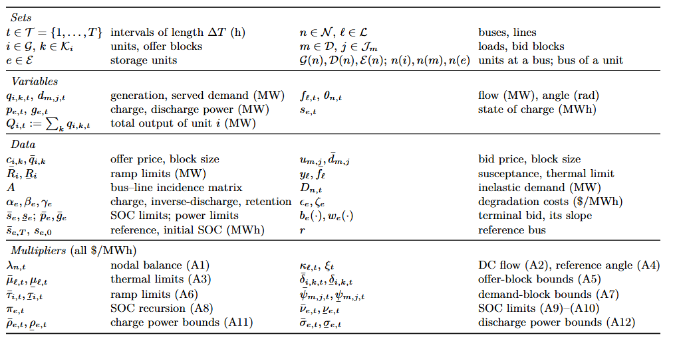
2.3 · MODEL A
The expanded ISO clearing problem
OBJECTIVE CONSTRAINTS · WITH THEIR MULTIPLIERS
All constraints affine ⇒ a constraint qualification holds automatically. Power constraints carry ΔT on their multiplier; the energy constraints (A8)–(A10) do not.

Slide 6
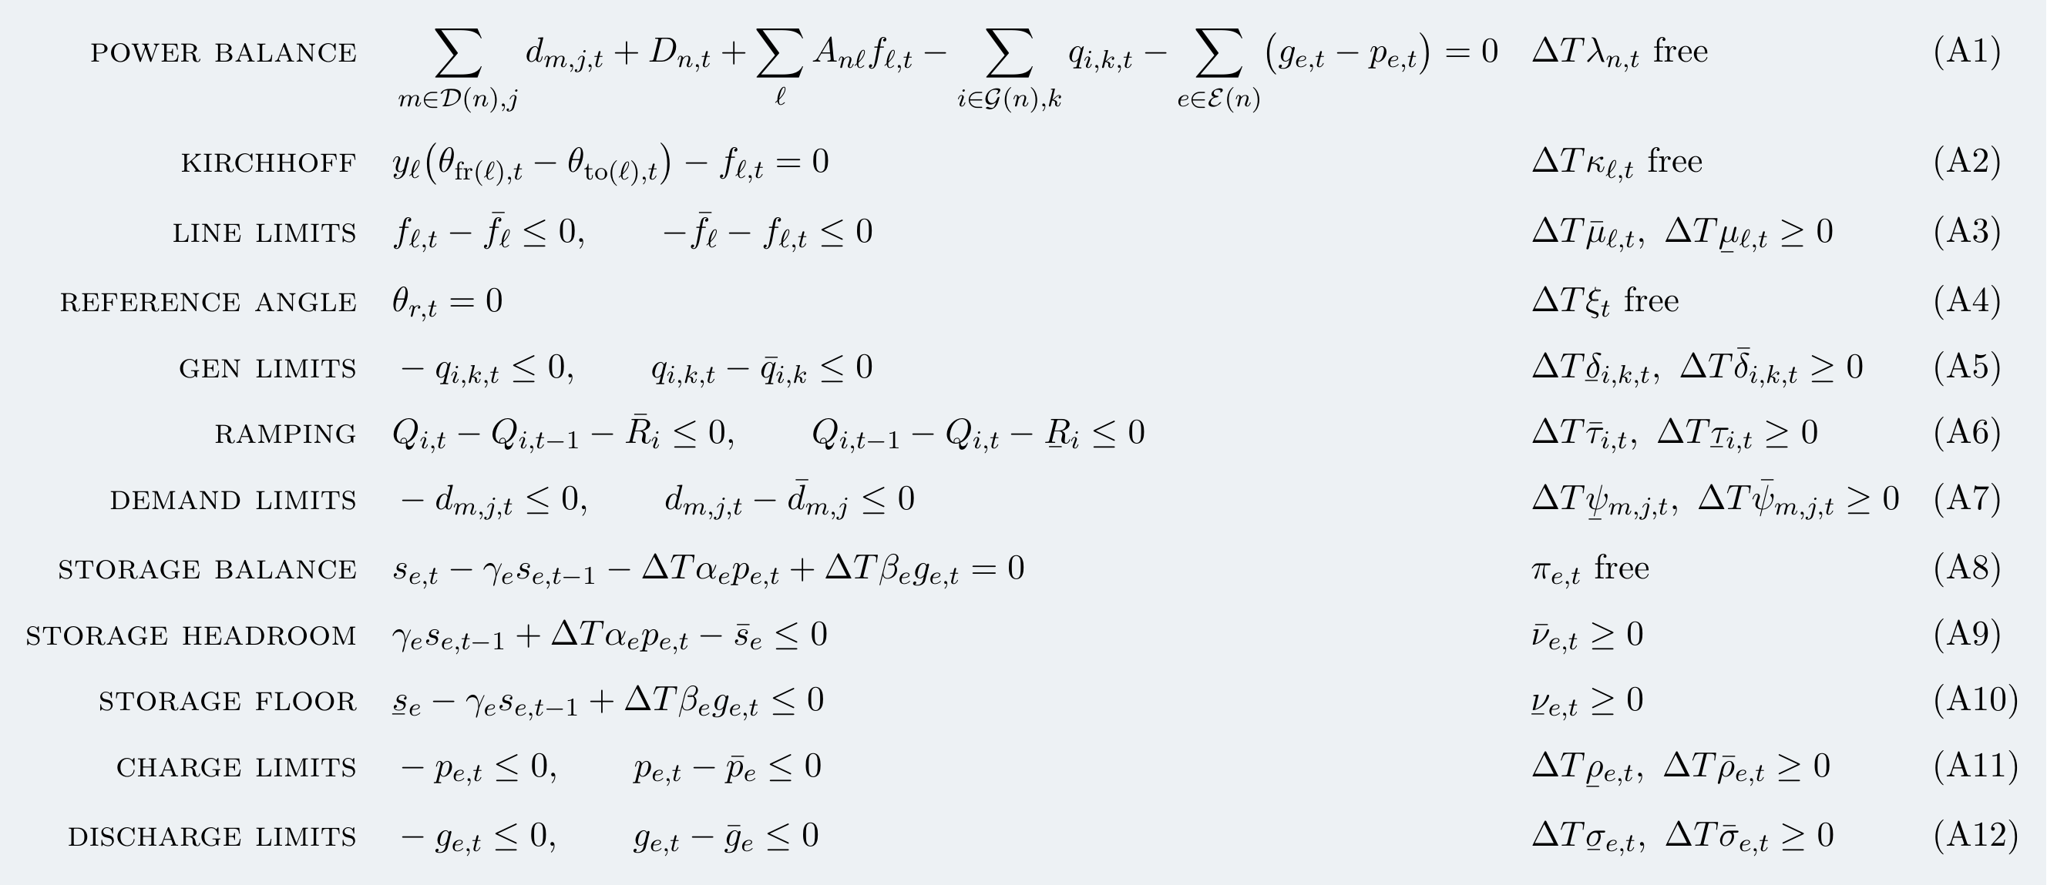
2.3 · MODEL A
The expanded ISO clearing problem
OBJECTIVE CONSTRAINTS · WITH THEIR MULTIPLIERS
All constraints affine ⇒ a constraint qualification holds automatically. Power constraints carry ΔT on their multiplier; the energy constraints (A8)–(A10) do not.

Slide 7
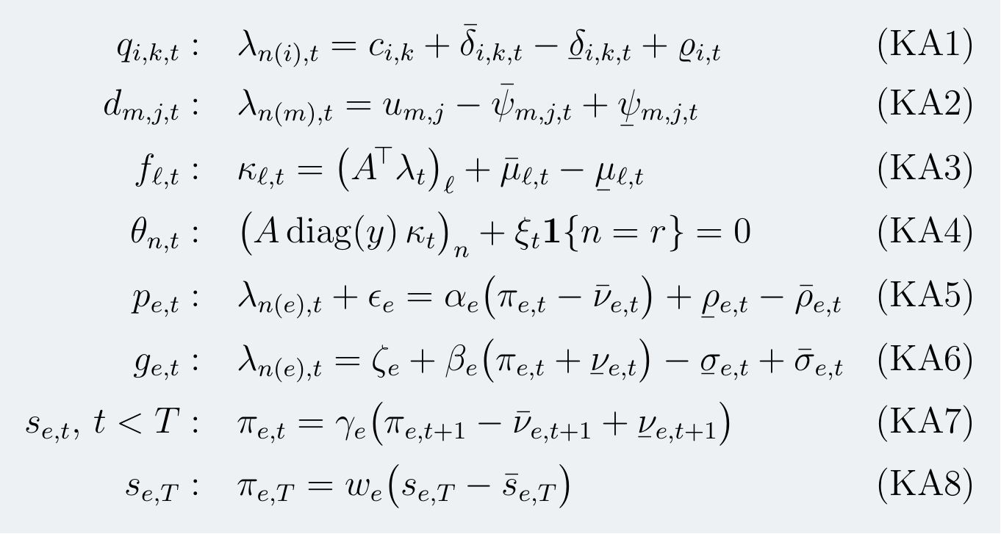
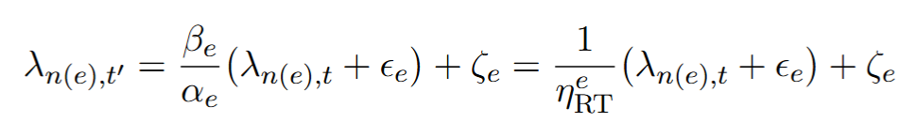
2.4 · MODEL A
Its KKT system — stationarity, one row per variable
(KA1)–(KA8)
Arbitrage decision
no SOC bound binding
(KA4) gives ξ = 0 on left-multiplying by 1ᵀ, since 1ᵀA = 0 — so it reduces to the dual form of Kirchhoff's voltage law.

Slide 8
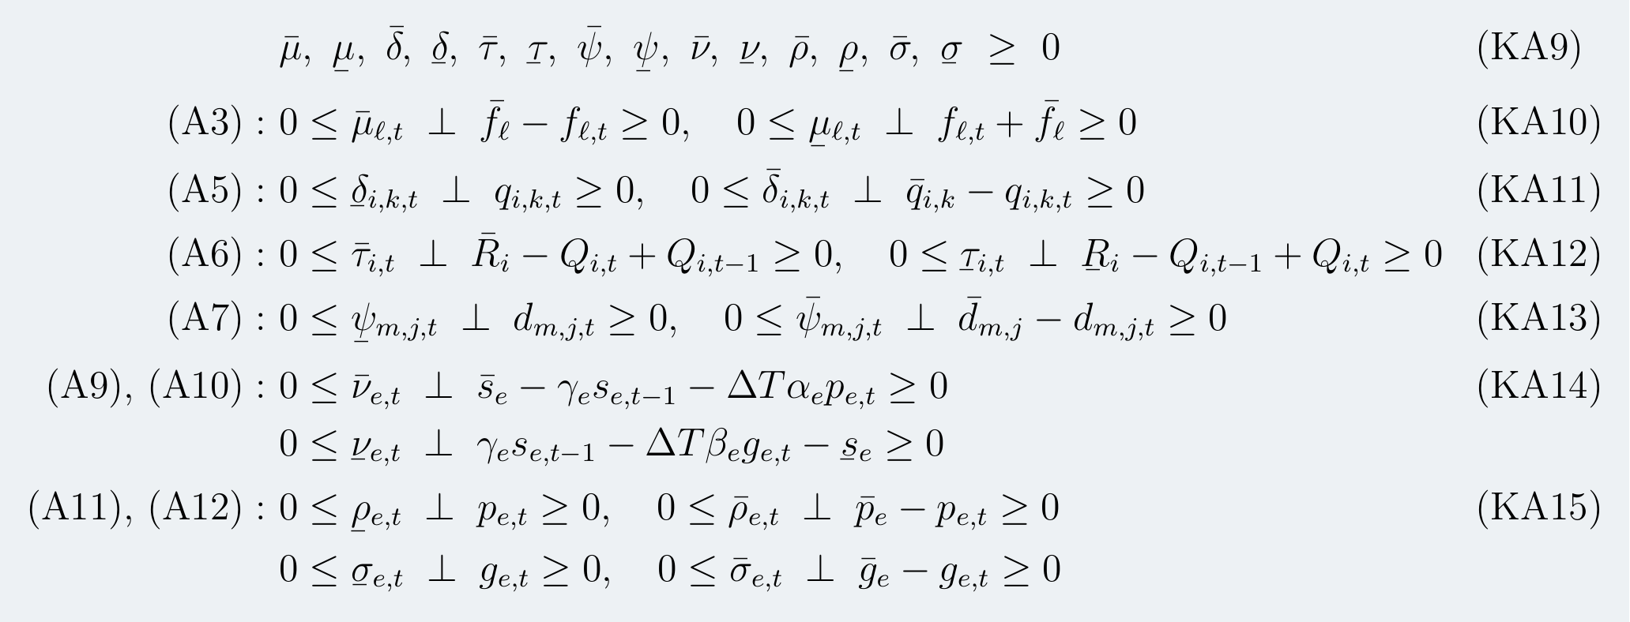
2.5 · MODEL A
Dual feasibility and complementary slackness
(KA9)–(KA15)
Plus primal feasibility (A1)–(A12). This is the complete optimality system of the ISO's problem — every multiplier belongs to the operator.

Slide 9
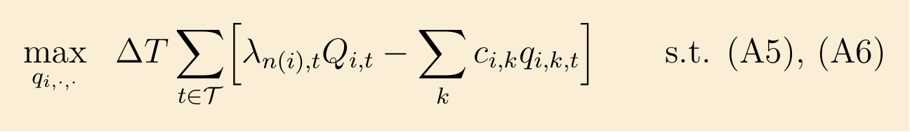
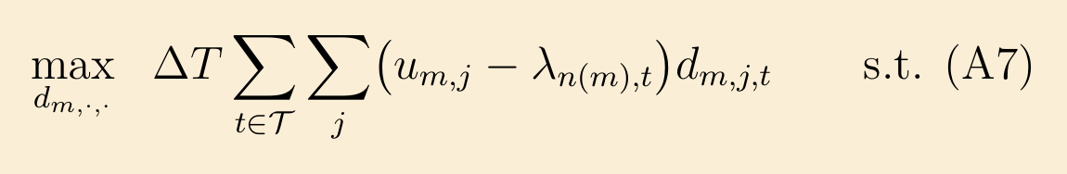
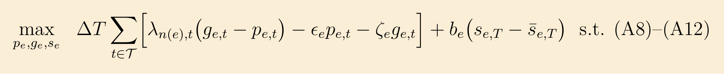
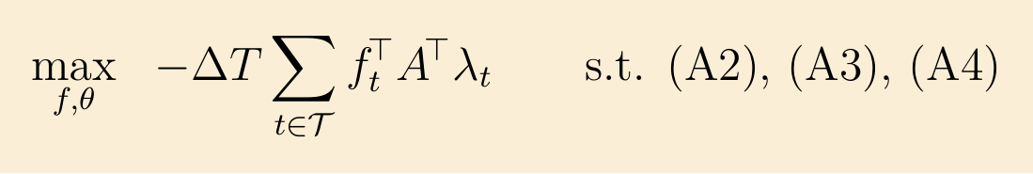
2.6 · MODEL B
The multi-agent model: one problem per participant
Each is solved by a price-taking participant that treats λ as given and is subject only to its own constraints. None of the four mentions welfare.
(B1) GENERATOR i
(B2) LOAD m
(B3) STORAGE OWNER e
(B4) NETWORK
(B4) is a modelling device: no merchant transmission firm exists. It is the operator enforcing Kirchhoff, written as an agent so the network block decentralises too.

Slide 10
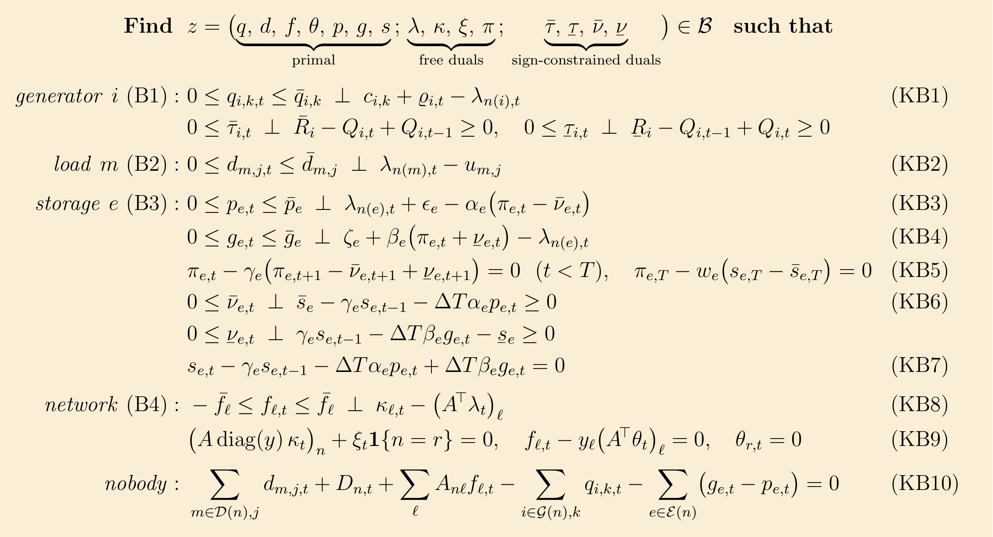
2.7 · THE MCP
Model B in full: one square system, no objective
Over the box ℬ: 0 ≤ q ≤ q̄, 0 ≤ d ≤ d̄, −f̄ ≤ f ≤ f̄, 0 ≤ p ≤ p̄, 0 ≤ g ≤ ḡ, τ̄, τ̱, ν̄, ν̱ ≥ 0, with θ, s, λ, κ, ξ, π free.

Slide 11
3
Assumptions
What has to hold before the word “equilibrium” can be used

Slide 12
3.1 · ASSUMPTIONS
Three hypotheses, doing three different jobs
Assumption 1 · Bid validity
w(e) is non-increasing for every e — equivalently, b(e) is concave. A statement about the curvature of a function.
Assumption 2 · Convex market
No binaries; losses neglected or convexly linearised; offer stacks non-decreasing and demand stacks non-increasing. A statement about the shape of a set.
Assumption 3 · Price taking
Each participant treats λ as given, and the whole horizon is financially binding. A statement about what the participants' problems actually are.
Separability by ownership is a fourth, and independent, hypothesis: it is about the sparsity pattern of the constraint matrix, not about curvature or shape.

Slide 13
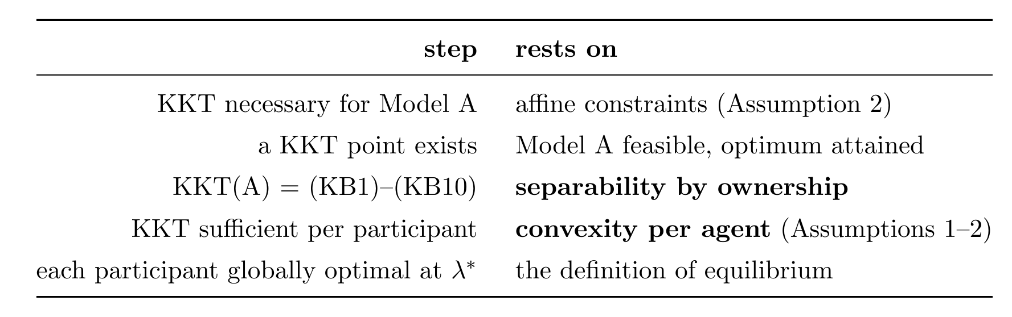
3.3 · THE ARGUMENT
Five steps, resting on different hypotheses
Separability buys the partition. Convexity buys the economics. Neither implies the other — which is why they are stated as separate hypotheses.
Existence needs its own argument: an “if and only if” between two empty sets is vacuous. Monotonicity gives a closed convex solution set; non-emptiness needs feasibility and boundedness.

Slide 14
4
Conclusion
What is established, and what is not

Slide 15
4.2 · CONCLUSION
What is established, and what is not
NOT ESTABLISHED
ESTABLISHED
The compact model expanded, with every constraint traced to its origin
Model B stated independently, as an MCP over a box
KKT(A) is partitioned by the agents' systems — uses separability only
Under Assumptions 1–3, a solution is a competitive equilibrium
Individual rationality and revenue adequacy follow
Rolling horizon, the theorem needs the full horizon binding (the paper just runs 1 day so it can not be seen the real value of the opportunity costs)
In real-time markets they can deviate from what is stablished in the DA market, so the forecast error mitigations disappears.
Ancillary services are not co-optimized in the paper, ERCOT is searching a way to introduce ESS more effectively in the AS, but that is not covered in the paper.
Non-convex extensions: unit commitment, AC network, w(e) being increasing
Hybridization, how does that affect to the system and the forecast error mitigation.
The second column is not a list of failures — it is the scope statement the theorem needs in order to mean anything.

Slide 16
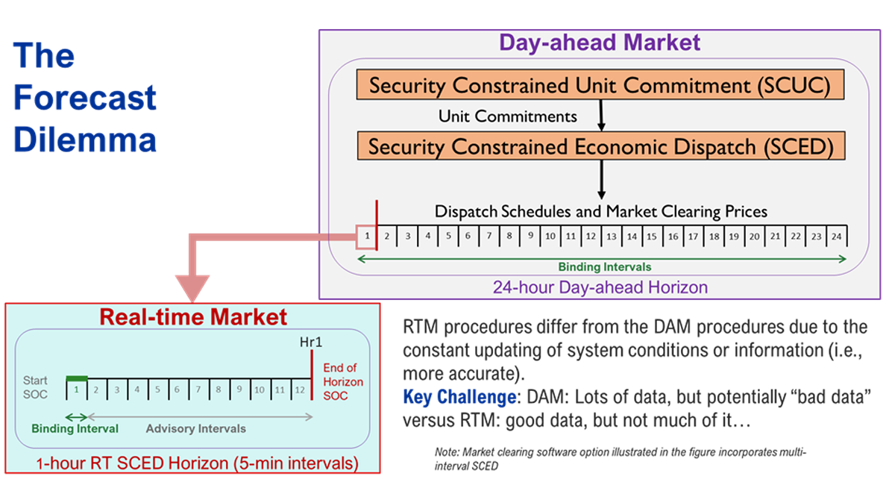
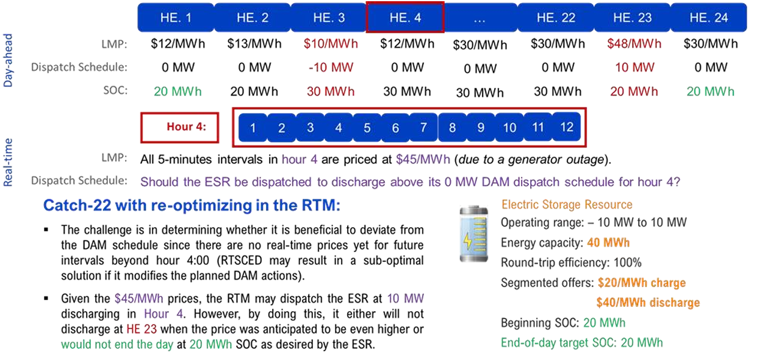
4.2 · CONCLUSION
ERCOT dilemma RTM vs DA
The second column is not a list of failures — it is the scope statement the theorem needs in order to mean anything.

Slide 17
Where this leaves us
The mechanism is understood, the correspondence is proved, and the equilibrium claim now carries its assumptions explicitly. What the design does is move the intertemporal opportunity cost from a forecast the participant must make to a dual the operator computes, π(e,t).
Open for discussion: truthfulness, rolling horizon, hybrids.

